Slide 1
MOS Integration

Slide 2
Simple NMOS Device Cross-Section
G
S
+ve
D
+ve
FOX
GOX
N+
+
+
+
+
N+
-
P-
B

Slide 3
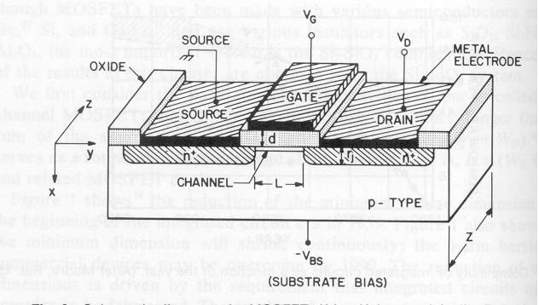
3 Dimensional Cross Section

Slide 4
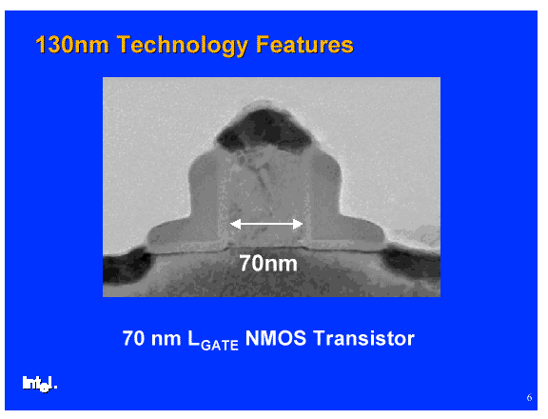

Slide 5
0V
Accumulation
+0.1
+
+
+
+
-
-
-
-
+
+
+
-
-
-
-
-
-
+
+
-
-
-
-
+
+
+
+
+
-
+
-
-
-
-
+
+
-
N
N
-
-
-
-
-
-

Slide 6
+Ve
Depletion
+0.1
+
-
-
-
-
+
+
-
-
-
-
-
+
+
+
+
-
-
-
-
-
+
+
-
+
+
+
+
N
-
+
+
-
-
-
-
+
N
+
-
-
-
-
-
P

Slide 7
++Ve
Inversion
+0.1
-
-
-
-
-
-
-
-
-
-
-
-
-
-
-
-
-
-
-
-
-
-
-
-
+
+
-
-
-
-
+
+
-
+
+
-
-
-
-
+
-
+
+
+
+
N
-
-
-
-
-
-
+
+
N
+
-
-
-
-
-
-
-
P

Slide 8
Threshold Voltage Plot
For An NMOS Device
Ids
Vgs
Vt

Slide 9
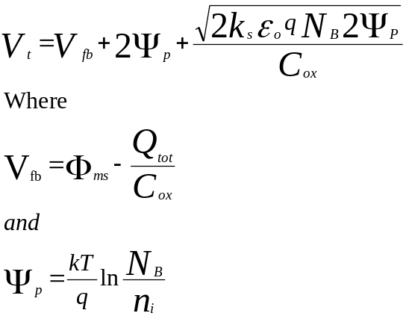
Threshold Voltage
The threshold voltage is determined from the equation

Slide 10
Flat Band Voltage
G
S
+ve
D
+ve
FOX
GOX
N+
N+
Total oxide charge
is the sum of the
Fixed Charge Qss
and
Mobile Charge Qm
Body Effect
P-
B
Metal Semiconductor Work Function
difference depends on the type of metal
(poly) used as the gate electrode
Gate Oxide Capacitance

Slide 11
Simple NMOS Device Cross Section
G
S
+ve
D
+ve
FOX
GOX
N+
N+
P-
B
Intrinsic carrier concentration
representative of the number
of minority carriers in the
channel region
Bulk concentration, or majority carrier concentration,
the greater the number of carriers the higher the voltage
needed to invert the surface

Slide 12
Substrate Concentration Nb (atoms/cm³)
6
N channel
5
p-type boron
4
substrate
Threshold
3
Voltage
2
(Vt)
1
(volts)
0
-1
E15
E16
E17
-2
E14
-3
-4
P channel
-5
n-type phos
-6
substrate

Slide 13
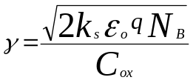
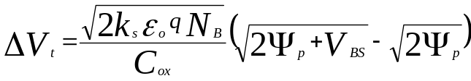
The Body Effect
Affect of Back Bias on Threshold Voltage
Vbs=0
Vbs=-1v
Ids
Vgs

Slide 14
Output Characteristics for an NMOS Device
Ids
Vgs 5
Vgs 4
Vgs 3
Vgs 2
Vgs 1
Vgs 0
Vds
The equations which describe this operation are:
I
=
μ
C
W
⎛
V
−
V
−
V
⎞
V
⎜
DS
⎟
D
ox
L
⎜
GS
t
2
⎟
DS
n
(
⎝
)
⎠
where
V
DS
<<
V
G
−
V
t
For the linear region

Slide 15
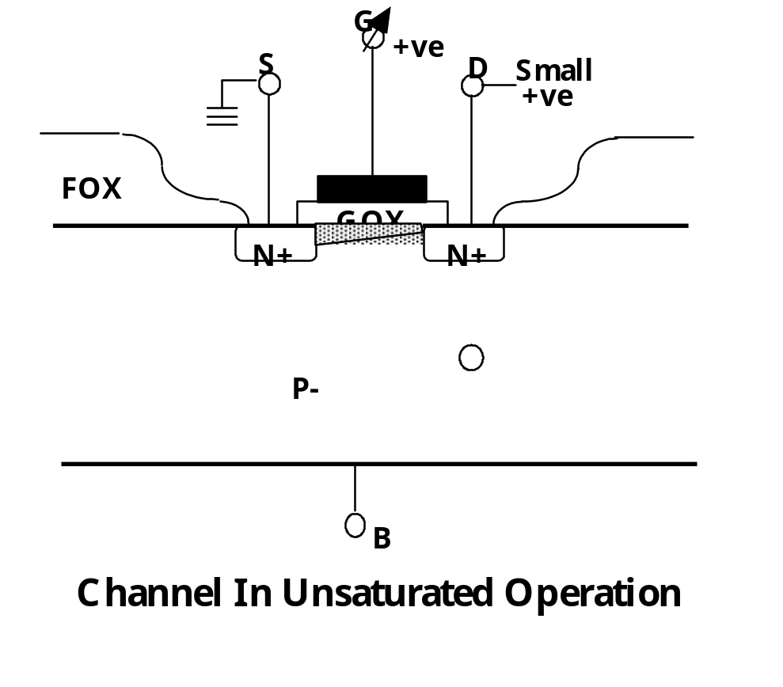
Channel In Unsaturated Operation

Slide 16
W/L of a MOS Transistor
Active Area
W
Field Area
Source
Drain
L
Polysilicon

Slide 17
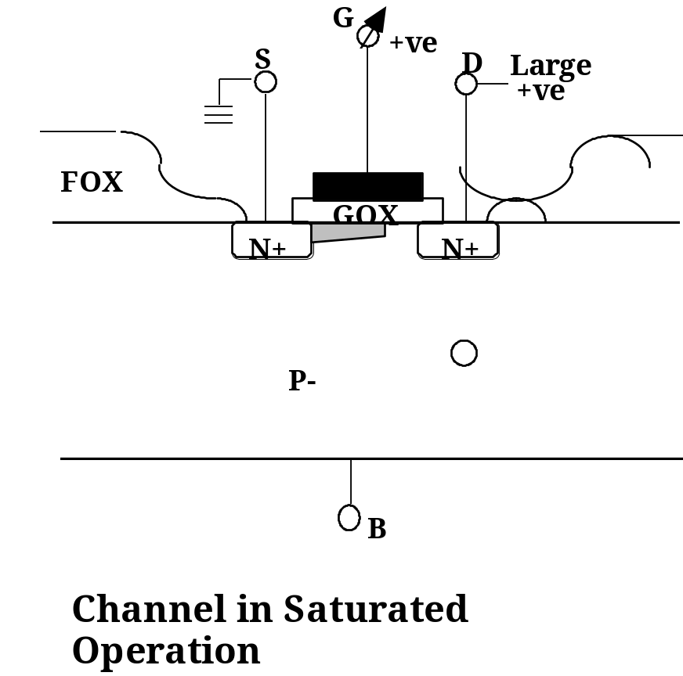
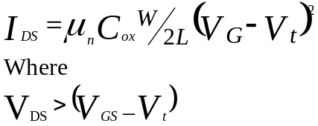
Channel in Saturated Operation
For the Saturated Region

Slide 18
Design Rules
The design rules for a process are the rules given by the process engineers to the designers which they must observe when doing the layout for a circuit.
The factors affecting these rules are as follows:

Slide 19
1.The minimum resolution of the photolithography system in use.
2.The alignment accuracy of the photolithography system
3.The junction depth of the diffusions and the side ways diffusion
4.The power supply voltages to be used on the circuit
5. The doping levels of the substrate and the diffused functions
6. The combination of items 4 and 5 which will give a maximum depletion region spreading

Slide 20
1. Minimum Resolution
Dependant on the lithography equipment available
Should be some “comfort factor” above the minimum equipment capability
Not all lines/shapes have to be drawn to minimum dimension

Slide 21
2. Alignment Accuracy
Equipment dependant
Alignment scheme dependant
Alignment errors accumulate!
Typical rule of thumb, alignment accuracy should be better than1/4 minimum resolution
Max N/S alignment
Max E/W alignment
1
1
1

Slide 22
3. Junction Depth and Sideways Diffusion
Oxide
Oxide
Junction
Sideways Diffusion

Slide 23
4 & 5 Supply Voltages and Substrate Doping
Reverse Bias
Reverse Bias
Junction
Depletion Region

